Slide 1


MP-II Project
TITLE : Covid outbreak prediction using machine learning
Team members=Depa Sai Charan 201003038 (Team lead)
Ganesh neela 2010030203
Gokul Vinakollu 2010030181
Adla pavan kumar 2010030199

Slide 2
ABSTRACT
The coronavirus (COVID-19) outbreak produced devastating effects on the global economy and the health of entire communities. Although the COVID-19 survival rate is high, the number of severe cases that result in death is increasing daily. A timely prediction of at-risk patients of COVID-19 with precautionary measures is expected to increase the survival rate of patients and reduce the fatality rate. This research provides a prediction method for the early identification of COVID-19 patient’s outcome based on patients’ characteristics monitored at home, while in quarantine. The data were analyzed using three classification polynomial regression, SVM
Prediction, Prophet Model Initially , the data were preprocessed using several Preprocessing techniques. Furthermore,10-k cross-validation was applied for data partitioning

Slide 3
INTRODUCTION
The year 2020 has been a disastrous year for humankind. We humans, all around the globe have come across the Coronavirus. It was first identified in December 2019in Wuhan, China. The World Health Organization declared the outbreak a Public Health Emergency Concern on 20 January 2020, and later a pandemic on 11 March 2020. As of 3 April2021, more than 130 million cases have been of — International confirmed, with more than 2.84 million deaths attributed to COVID-19, making it one of the deadliest pandemics in history. India witnessed an outbreak of COVID-19,during the last week of January 2020 when a few Indian students travelled to Kerala from Wuhan located in China. In 2020, from January to till today, we have not been able to get rid of the virus. As per the World Health Organization (WHO), numerous potentialCOVID-19 antibodies are being examined, and many voluminous clinical trials may report their results later at the near end of2020 or the very beginning of 2021. WHO is working with partners around the world to help coordinate with the key steps in this process Companies such as Biotech have concluded a phase 3 study of theCOVID-19 vaccine and claim to be 95%sufficient against the virus.

Slide 4
LITERATURE SURVEY
SL.NO | AUTHOR | YEAR | LITERATURE SURVEY
1 | DR.Kumar | 2019-2020 | Used the ARIMA model for predicting the outbreak in the top 15 European countries.
2 | DR.Tuli | 2019-2020 | Proposed an ML model that can run continuously on Cloud Data Centers (CDCs) for precise prediction of spread and proactive development of strategic response by the government and citizens
3 | DR. Robust Weibull | 2019-2020 | Proposed the data on the spread of COVID-19 in the top 10 densely populated countries, viz., India, Bangladesh, the Democratic Republic of Congo, Pakistan, China, Philippines, Germany, Indonesia, Ethiopia, and Nigeria were analyzed
4 | DR.Tomar | 2019-2020 | have used data-driven estimation methods like, long short-term memory (LSTM) and curve fitting for prediction for the monthly number of COVID-19 cases in India and also the effect of preventive measures like, social isolation and lockdown on the spread of COVID-19.
5 | DR. Prabodh Kumar | 2019-2020 | have applied cluster analysis, to classify real groups of infectious disease of COVID-19 on a data set of different states and union territories in India, based on their high similarity to each other.

Slide 5
Objective: The main goal of this thesis is to develop a machine learning model that could predict the outbreak of COVID-19 . To develop such a model, a literature study alongside an experiment is set to identify a suitable algorithm. To assess the features that impact the prediction model.

Slide 6
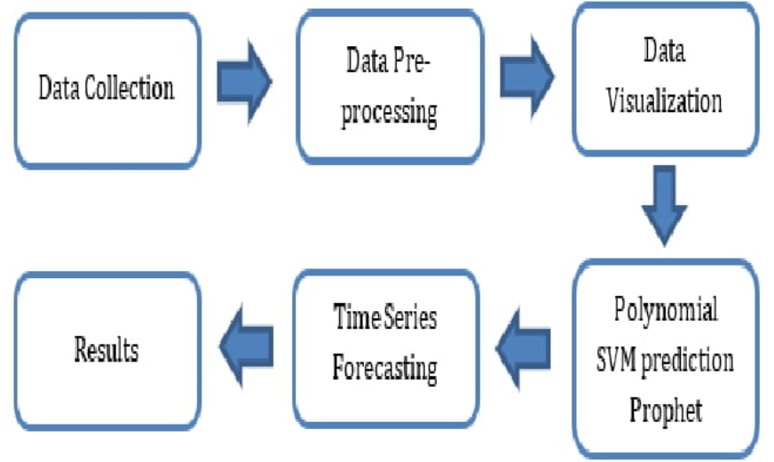
METHODOLOGY

Slide 7
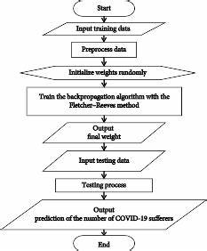
Implementation flow chart
SVM METHOD

Slide 8
A. Data Collection:
The data for the ongoing Covid-19outbreak in world as well as India is collected from . The columns of this dataset include the Total number of Confirmed, Active , Cured, and Death cases of Covid-19 patients accumulating all the states with countries on a day-to-day basis from 22th January 2020 to last date of toady.
B. Data Pre-processing:
In the section of data pre- processing, redundant or null values were removed by data cleaning. Further, we have set the column attributes as -"Confirmed, Active, Cured and Deaths cases" for which the dependent variable and "Dates" as_ the independent variable.
C. Data Visualization:
A Heat Map visualization could be combination of coloured rectangles, each representing a quality component that permits clients to rapidly get a handle on the state and effect of an expansive number of factors at one time.

Slide 9
D. Polynomial regression model:
We have employed the model of polynomial regression provides __ the relationship between the dependent variable Y and the independent variable X and is modelled as 2nd, 3rd, 4th, and 5th-degreepolynomial in x. here we choose fix degree because of large covid-19 time series data set world and India .
E. SVM model:
The second type of regression analysis that we have used is SVM (Support Vector Machines) time series prediction model. SVM are used for time series prediction and compared to radial basis function networks.

Slide 10
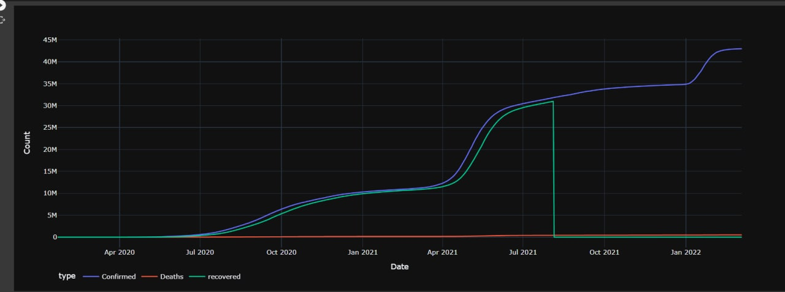
OUTPUTS
RECOVERED CASES
DEATH CASES
ACTIVE CASES

Slide 11
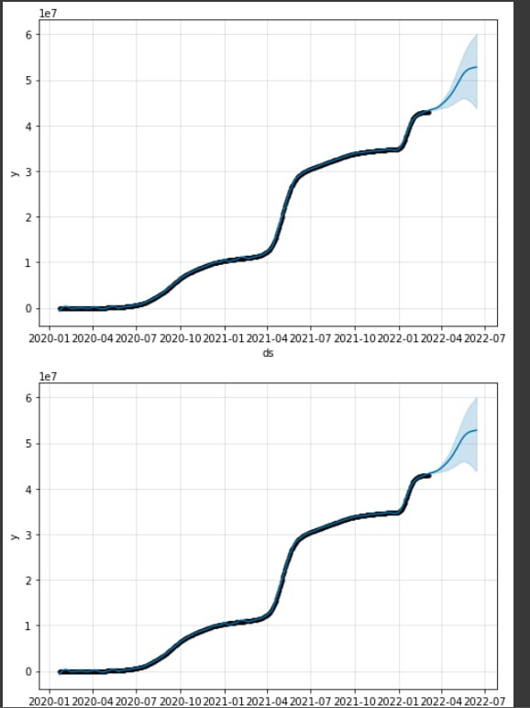
PREDICTION ANALYSIS

Slide 12
CONCLUSION
In the present study, we conducted an experimental study in the forecasting of theCOVID-2019 epidemic pattern and have also compared the differences of actual and predicted values in both principle and practical aspects. Moreover, based on weighted overlay, the district is classified in toa very high, high, medium and low risk zone of COVID-2019. The Prophet model can acquire past values and consider current and preceding residual series _ historical knowledge. An efficient linear model to efficiently capture a linear pattern of theCOVID-19 disease series was demonstrated in the Prophet model. In general , decomposition methods operate best when the sequence is compatible with the hypothesis for decomposition. The drawback of the model is that only the data from the time series can derive linear relationships. With events which may be influenced by multiple factors, including several meteorological and specific social influences , this does not work well.

